Slide 1
Osmotic Pressure
By Author
Date

Slide 2

$$Π$$
Pure Water
Salt Water
Semipermeable Membrane

Slide 3
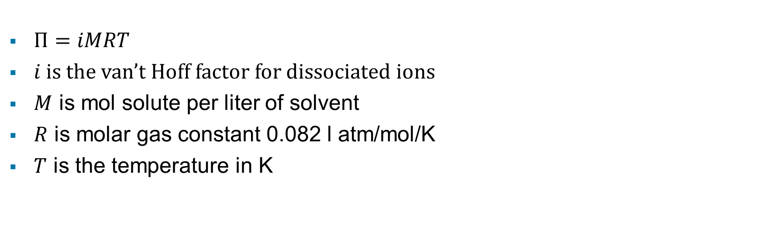
$Π=iMRT$
$i$ is the van’t Hoff factor for dissociated ions
$M$ is mol solute per liter of solvent
$R$ is molar gas constant 0.082 l atm/mol/K
$T$ is the temperature in K

Slide 4
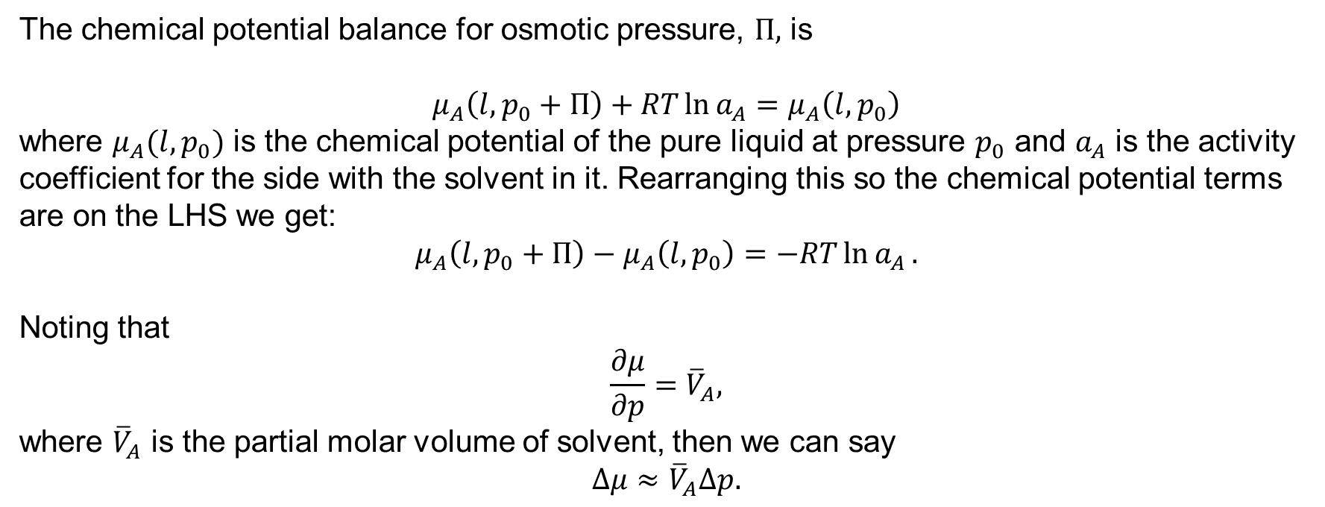
The chemical potential balance for osmotic pressure, $Π,$ is
$$μ_{A}\left(l, p_{0}+Π\right)+RT\ln{a_{A}}=μ_{A}\left(l, p_{0}\right)$$
where $μ_{A}(l, p_{0})$ is the chemical potential of the pure liquid at pressure $p_{0}$ and $a_{A}$ is the activity coefficient for the side with the solvent in it. Rearranging this so the chemical potential terms are on the LHS we get:
$$μ_{A}\left(l, p_{0}+Π\right)−μ_{A}\left(l,p_{0}\right)=−RT\ln{a_{A}}.$$
Noting that
$$\frac{∂μ}{∂p}={\overline{V}}_{A},$$
where ${\overline{V}}_{A}$ is the partial molar volume of solvent, then we can say
$$Δμ≈{\overline{V}}_{A}Δp.$$

Slide 5
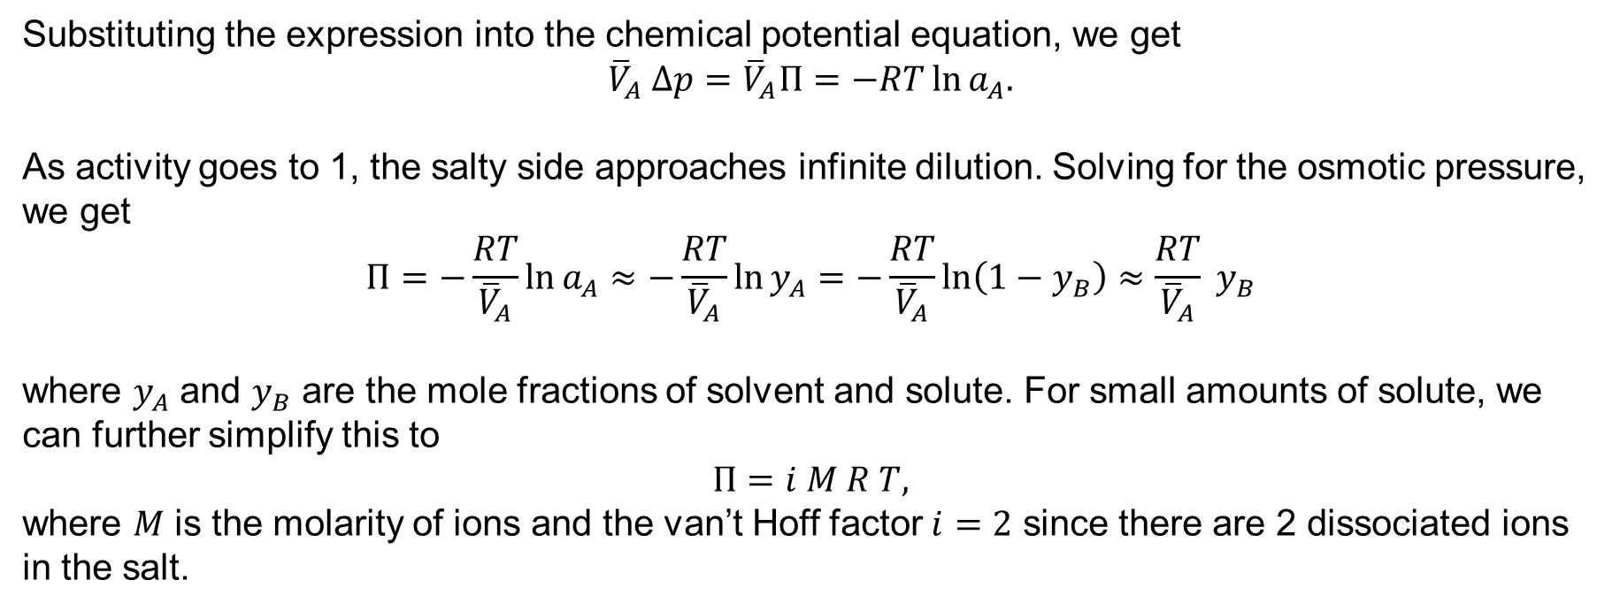
Substituting the expression into the chemical potential equation, we get
$${\overline{V}}_{A} Δp={\overline{V}}_{A}Π=−RT\ln{a_{A}.}$$
As activity goes to 1, the salty side approaches infinite dilution. Solving for the osmotic pressure, we get
$$Π=−\frac{RT}{{\overline{V}}_{A}}\ln{a_{A}≈−\frac{RT}{{\overline{V}}_{A}}\ln{y_{A}=−\frac{RT}{{\overline{V}}_{A}}\ln\left(1−y_{B}\right)≈\frac{RT}{{\overline{V}}_{A}} y_{B}}}$$
where $y_{A}$ and $y_{B}$ are the mole fractions of solvent and solute. For small amounts of solute, we can further simplify this to
$$Π=i M R T,$$
where $M$ is the molarity of ions and the van’t Hoff factor $i=2$ since there are 2 dissociated ions in the salt.

